Slide 1



The 46th International Conference on Software Engineering (ICSE 2024)
Beyond a Joke: Dead Code Elimination Can Delete Live Code
Haoxin Tu, Lingxiao Jiang, Debin Gao (Singapore Management University)
He Jiang (Dalian University of Technology)
18/04/2024, Lisbon

Slide 2
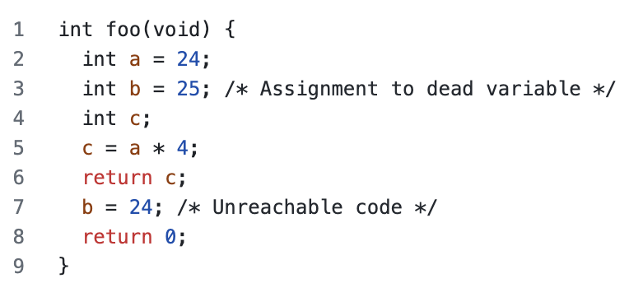
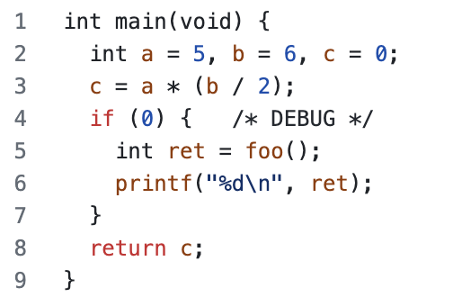
Background: Dead Code Elimination
What is Dead Code Elimination (DCE)?
A fundamental compiler optimization technique that removes dead code (e.g., unreachable or reachable but whose results are unused) in the program
Benefits of DCE: produce smaller or faster executables
Many other applications and languages (Java, Go, and Rust, etc.)
Examples are cited from https://en.wikipedia.org/wiki/Dead-code_elimination#Examples

Slide 3
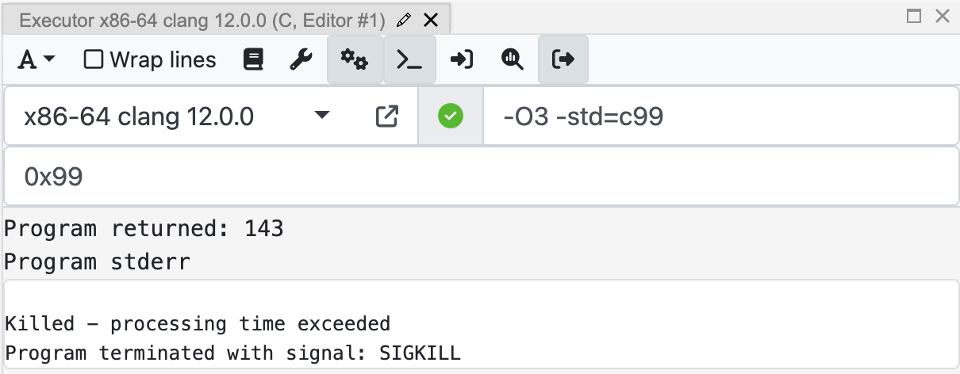
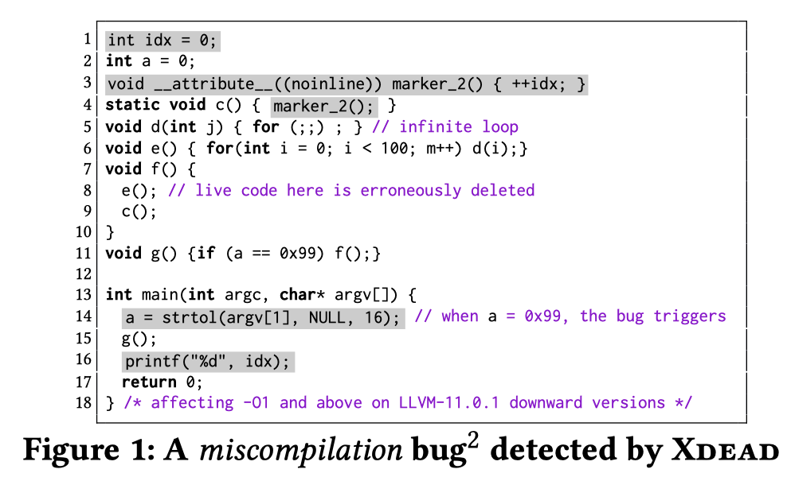
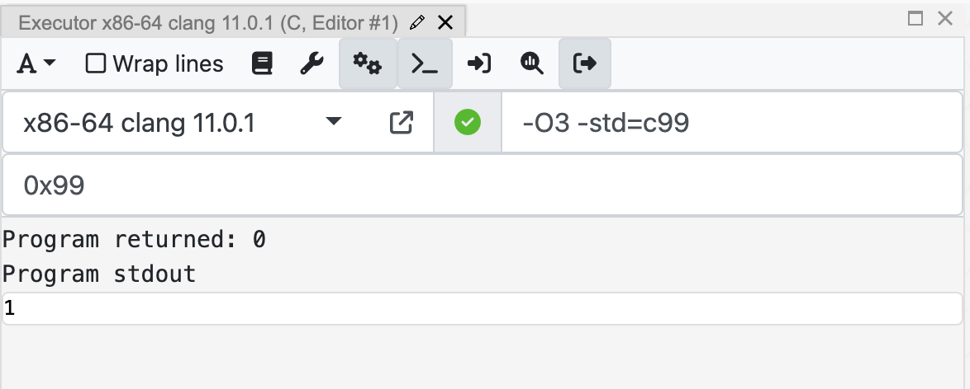
Motivation
Question: Can DCE happen to erroneously delete live code?
Motivating example
(Input)
(Output)
Executable 1
(Input)
(Output)
Wrong binary code
Executable 2
https://godbolt.org/z/z7zxexfr1

Slide 4
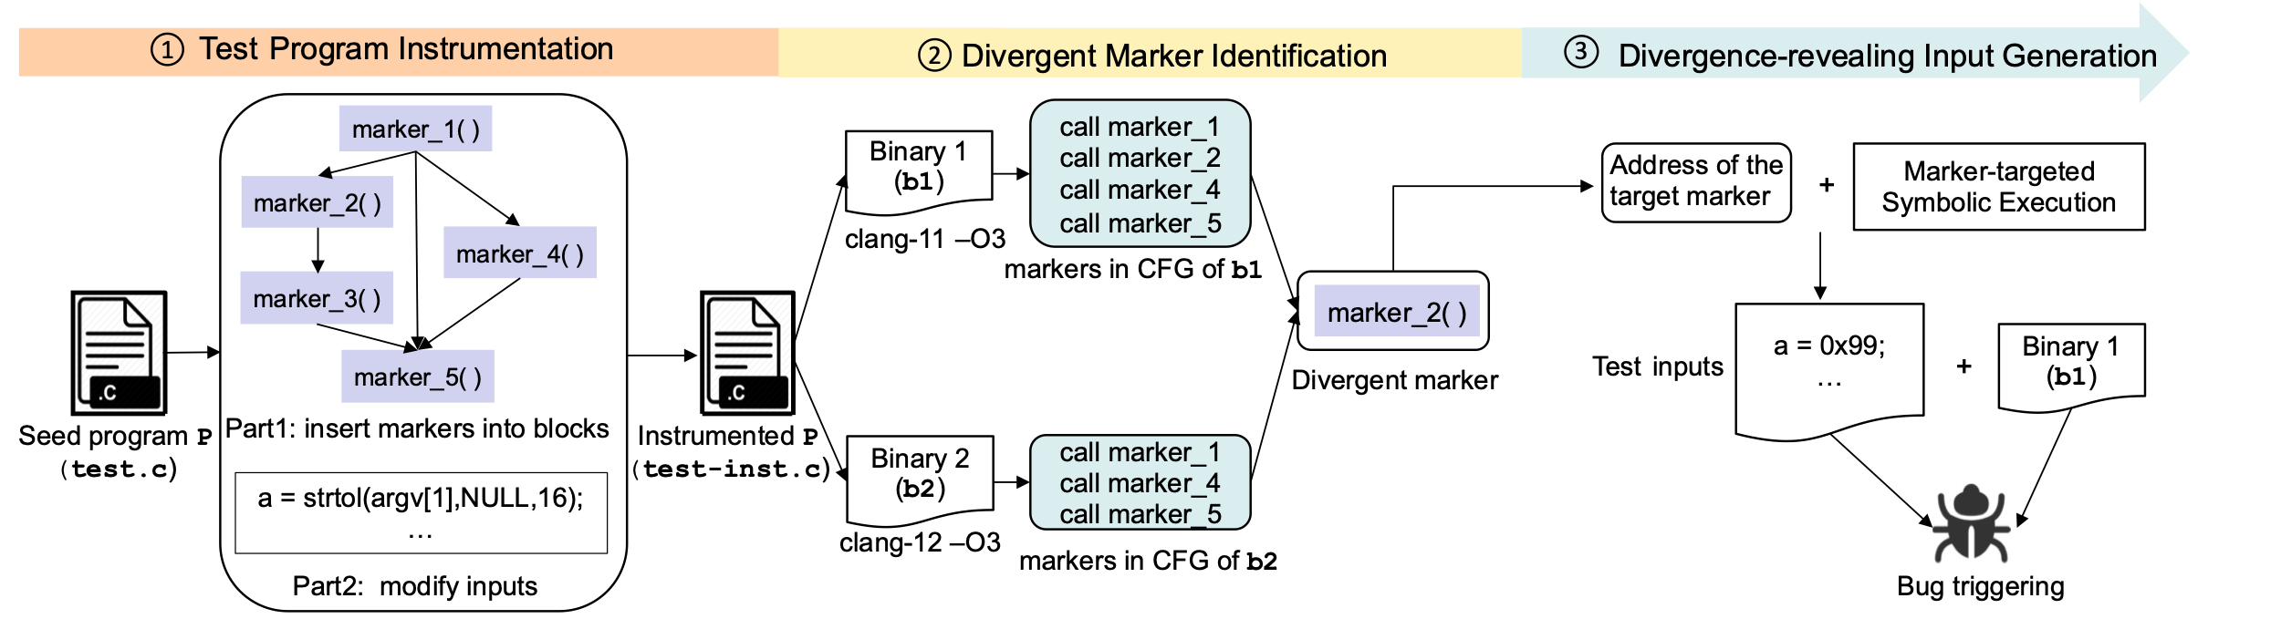

Solution: Xdead
Key insights: divergence indicates DCE bugs
Identify the divergent portions in binary first
leverage symbolic execution to reveal the divergent portion
ß
The marker function:

Slide 5
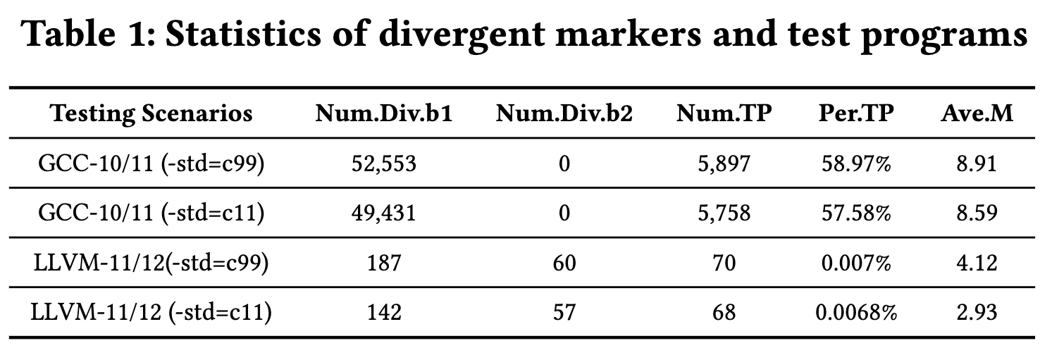
Preliminary results
Evaluation setup
Benchmark
10,000 seed program from Csmith
Subjects
GCC and LLVM
Running setting
four scenarios under “–O3”
Summary
Found many divergent portions indicating erroneously deleted live code (i.e., wrong compiler optimization opportunities)
Detected Two miscompilation bugs in LLVM compilers
Metric
Number of divergent markers
Number of bugs

Slide 6


Conclusion
Answer: DCE can erroneously delete live code sometimes (Solution: Xdead)
Future work
Utilize more fine-grained binary analysis to identify fine-grained divergent portions in Part 1
Improve the efficiency of Part 3
efficient path exploration
Paper
Code

Slide 7
Beyond a Joke: Dead Code Elimination Can Delete Live Code
The 46th International Conference on Software Engineering (ICSE 2024)
Thank you & Questions?
Haoxin Tu, Lingxiao Jiang, Debin Gao (Singapore Management University)
He Jiang (Dalian University of Technology)
18/04/2024, Lisbon

Slide 8
Retrospection of motivating example
Step 1: Test Program Instrumentation
Marker injection: Lines 3 and 4
Modify inputs: Lines 1, 14, and 16
Step 2: Divergent Marker Identification
“clang-11 –O3 test.c”
“clang-12 –O3 test.c”
Get CFG of the binaries and compare the marker existence
Step 3: Divergence-revealing Input Generation
Symbolize the input (i.e., variable a) in the program
Set the target to find (i.e., the address of function marker_2)
execute Angr (a binary symbolic executor)
Execution results
“Found a solution!”: e.g., 0x99
“No solution found”: not a DCE bug or Angr encounter difficulties

Slide 9
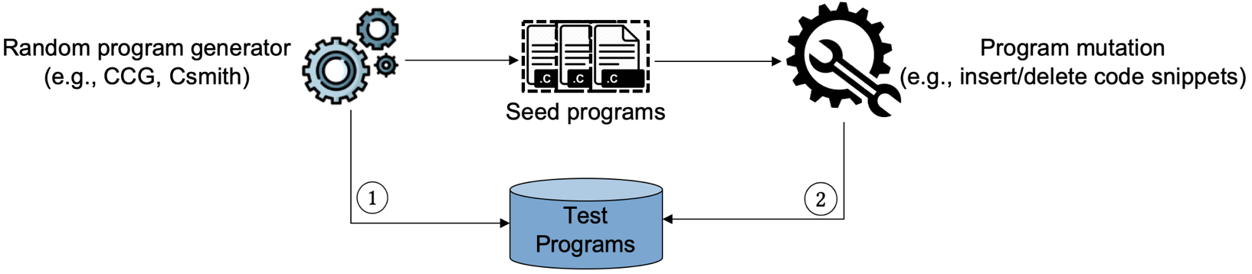
Related work
Compiler testing studies [1]
Generation-based: Csmith, YARPGen, etc.
Mutation-based: Orion, Athena, and Hermes, etc.
Randomly test compilers
Any inconsistencies in the outputs?
(semantic divergences)
[1] Tu, Haoxin, He Jiang, Xiaochen Li, Zhilei Ren, Zhide Zhou, and Lingxiao Jiang. "RemGen: Remanufacturing a random program generator for compiler testing." In IEEE 33rd International Symposium on Software Reliability Engineering (ISSRE), pp. 529-540, 2022.

Slide 10
Future work (1/2)
Insights
Reducing the search space of symbolic exploration could make targeted symbolic execution more efficient
Challenge 1: how to select important variables to be symbolized?
Not every variable contributes equally to revealing the divergent portion in binaries
Challenge 2: how to handle loops or function calls involved with symbolic variables?
Such loops or functions make the target symbolic execution inefficient
Notes:
For the extension of Xdead, during our experiments, we found that the number of divergent markers is pretty large. To help detect the DCE bugs efficiently, we need to reduce the seach space of symbolic exploration in the third step.
To do so, two challenges might be considered. One is xx. Another is xxx
Challenge 1: how to select important variables to be symbolized?
Not every variable contributes equally to revealing the divergent portion in binaries
Challenge 2: how to handle loops or function calls involved with symbolic variables?
Such loops or functions make the target symbolic execution inefficient

Slide 11
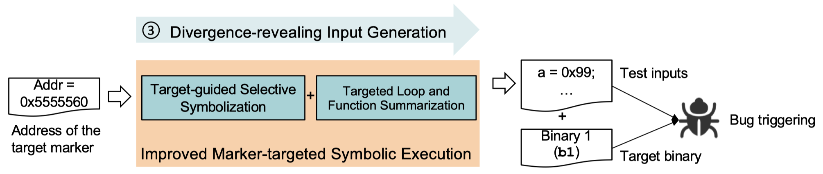
Future work (2/2)
Planned solution: efficient targeted symbolic execution
Addressing challenge 1: Target-guided selective symbolization
Data flow analysis to select variables that are directly to go through the divergent functions
Addressing challenge 2: Targeted loop and function summarizations
Handle loops and functions that involve symbolic variables

